Slide 1
Category review: Chips
June 2020
Retail Analytics
Brand note: If client logo is not required, use alternate title page layout right click slide thumbnail > Layout > Title

Slide 2
Notes:
To view Privacy video explaining how important data privacy is to Quantium, please click here: https://www.youtube.com/watch?v=Zq1QDAkoRzU
or here Q:\Company Reference\Brand & Design\Brand videos\Q Privacy.mp4
At Quantium, we believe that data is the behavioural footprint of humanity and that it has to be treated with the utmost care and responsibility.
Histories, attitudes, indeed lives are stored within it in ways that aren’t always apparent – and that’s what makes its potential so powerful.
To work with it responsibly, sensitively, we set ourselves the highest data privacy protection and governance standards.
We have spent 17 years perfecting privacy-by-design and secure-by-design principles. Central to this is not holding any personally identifiable information about people –
we neither receive it, and put the necessary protections in place to be unable to decipher it.
Every aspect of handling data is safeguarded: from its de-identification, to its encryption – data security is paramount and of the highest grade.
We pride ourselves on gaining the trust of iconic organisations around the world through years of securely working with their data,
and in turn the trust that builds with their stakeholders.

Slide 3
Executive summary
01
Chips Category Review
• Mainstream Single type/Young and Intermediate Facilitator has the highest chip expenditure per purchase.
• Old Families (Budget) have the highest purchase frequency, followed by Singles/Young Companion (Mainstream) and finally Retirees (Mainstream) contributing to a total of 25% of sales revenue.
• Chips Brand Kettle is a brand that is very much bought in all stores.
• Single/Young and Half-Age Companions are one of the segments that have Doritos as the highest buying brand while Smiths for the other segments.
• The size of the chip that is very often purchased is 175 grams with dimensions of 150 grams for all segments.
• Chip deals multiply just before Christmas which can be an advantage with the boost of promotional offers.
02
Store Analysis
• Trial stores 77 and 86 saw a significant increase in total sales and number of customers during the trial as
compared to control stores.
• Trial shop 88 is facing an increase as well but not as good as shop 77 and 86.

Slide 4
01
Chips Category Review

Slide 5
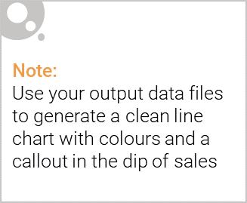
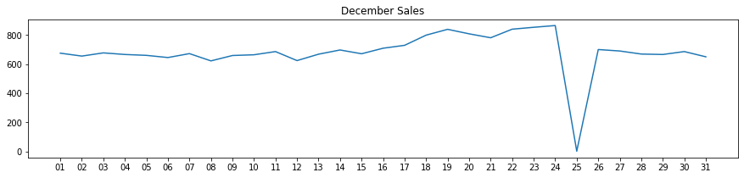
• The day without transactions is Christmas, which is when the shops are closed so there is a decrease in sales on December 25 because the shops are not operating.
• Sales continued to grow as Christmas approached and returned to early December sales levels throughout New Year's Eve.

Slide 6

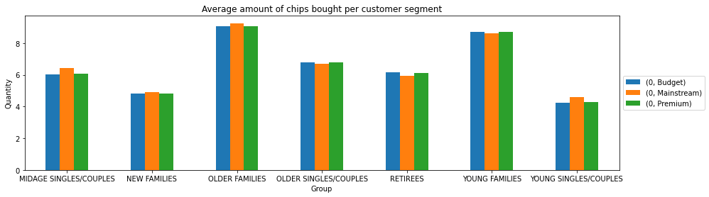
• The main sales come from Budget- old families, Mainstream- single/young companions, and Mainstream- retirees. In total contributed 25% of sales revenue.
• Old and Young Family segments have the highest average unit purchases per unique customer

Slide 7
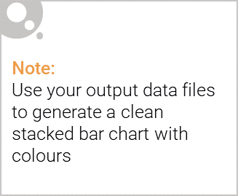
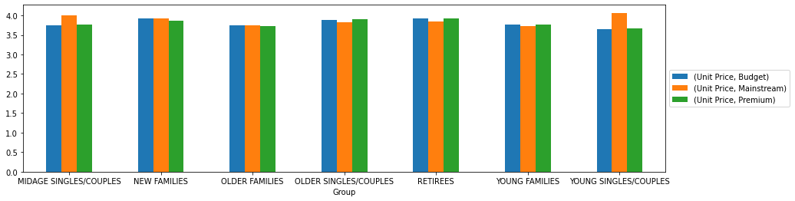
Editable (delete this)
• The most important sales come from Budget - elderly families, Mainstream - single/young couples, and Mainstream - retirees. What's more, older customers buy more than younger customers. Non-premium customers buy more than premium customers.

Slide 8
02
Trial store performance

Slide 9
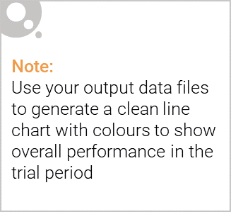
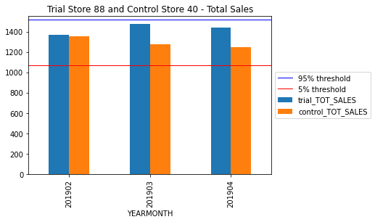
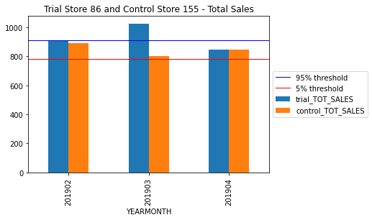
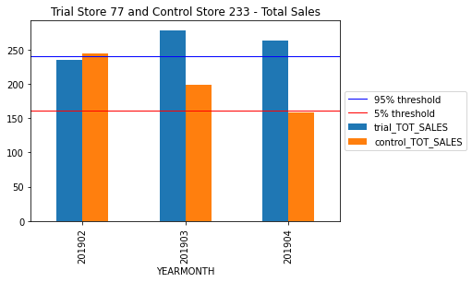
• We see that the February, March and April sales of the trial store 77 exceed the 95% threshold of the control store. The same applies to 86 sales for every 3 test months.
• While the sales increase in the test store 88 is insignificant.

Slide 10
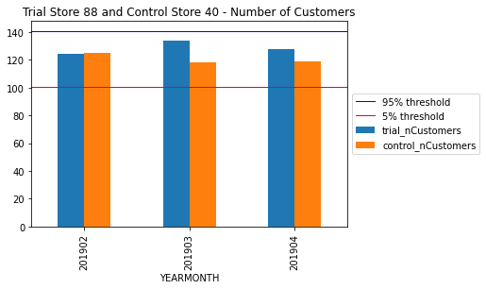
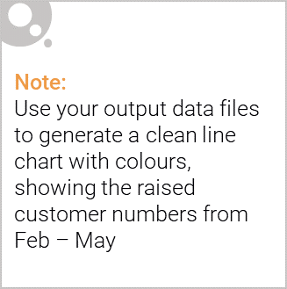
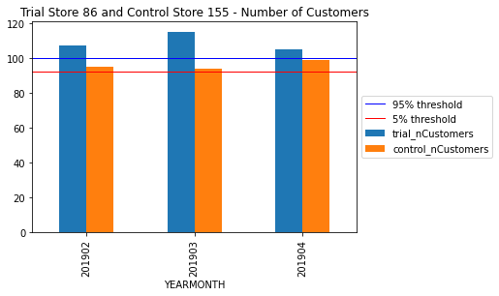
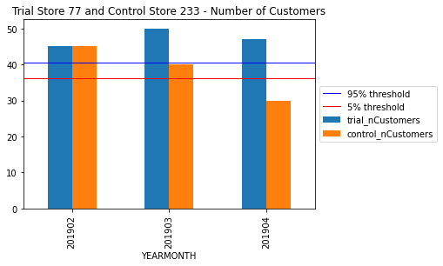
Trial store 77: Control store 233
Trial store 86: Control store 155
Trial store 88: Control store 40
Both trial store 77 and 86 showed significant increase in Total Sales and Number of Customers during trial period. But not for trial store 88. Perhaps the client knows if there's anything about trial 88 that differs it from the other two trial.
Overall the trial showed positive significant result.

